Slide 1
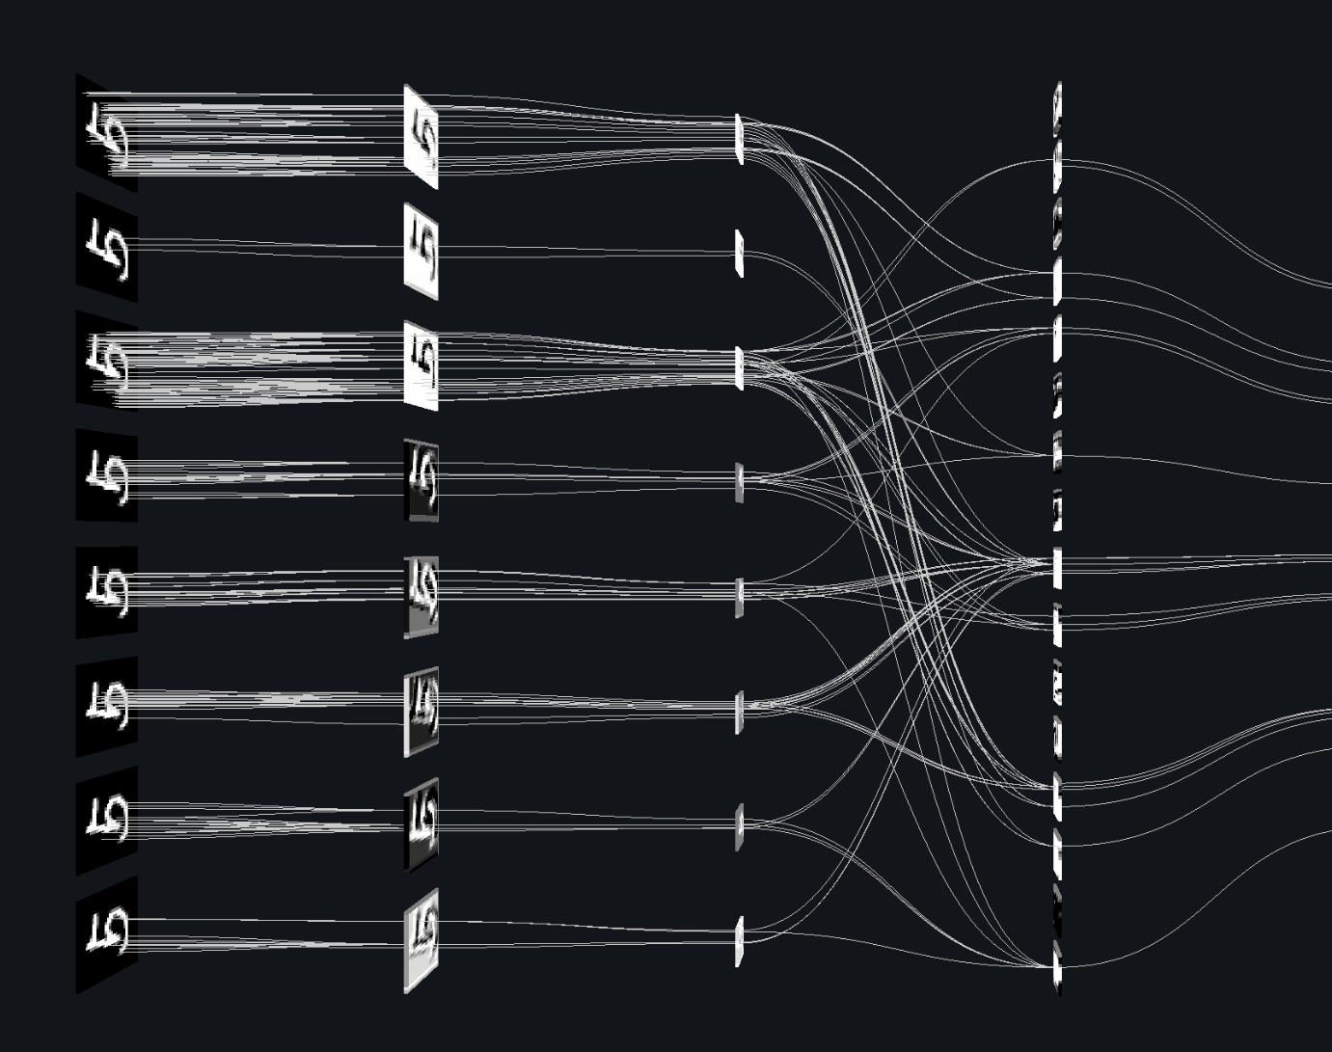
SPEECH EMOTION RECOGNITION USING CONVOLUTIONAL NEURAL NETWORK
YAVAR KHAN
HARDIK SAWHNEY
SAURAV GOYAL

Slide 2
INTRODUCTION
Speech Emotion Recognition (SER) is a systematic process which attempts to extract the underlying emotions of the user with the help of the user’s speech, pitch, and tone.
The model will be able to recognize emotion from sound files. We will load the data, extract features from it, then split the dataset into training and testing sets. Then, we’ll initialize the convolutional neural network and train the model. Finally, we’ll calculate the accuracy of our model.
The three key issues needed to be addressed for a successful Speech Emotion Recognition System are:
Choice of a good emotional speech database,
Extracting effective features, and
Designing reliable classifiers using machine learning algorithms.
In fact, the emotional feature extraction is a main issue in the SER system.

Slide 3
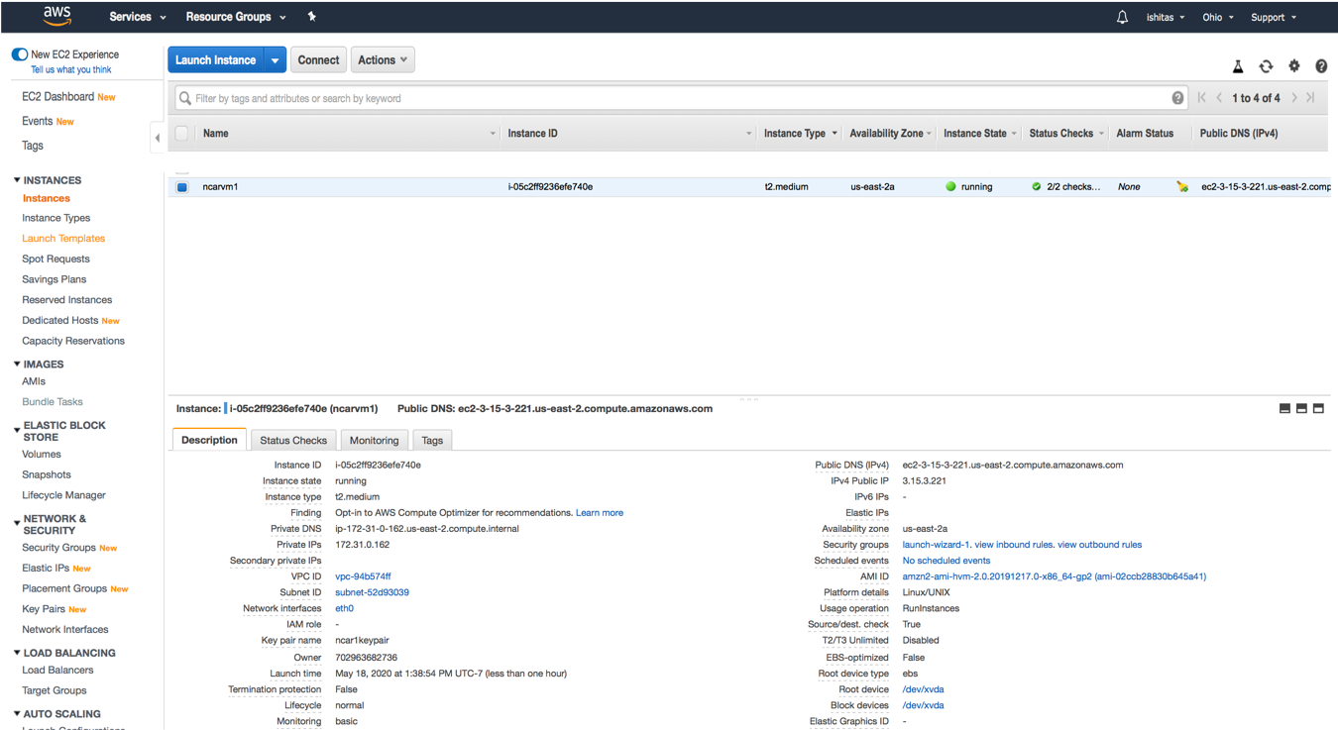
AWS CLOUD DEPLOYMENT
The codebase of the project was deployed on Amazon Web Services(AWS) EC2 instance.
An EC2 instance is like any other Linux machine utilizing cloud resources.
The project required training a neural network model with a huge dataset. This leads to an increase in processing time. In order to reduce the training time, AWS EC2 instances were scaled up in terms of compute resources and scaled down once the model training was complete.
This also helped the entire team to collaborate on the project by providing a single access point to the project codebase.

Slide 4
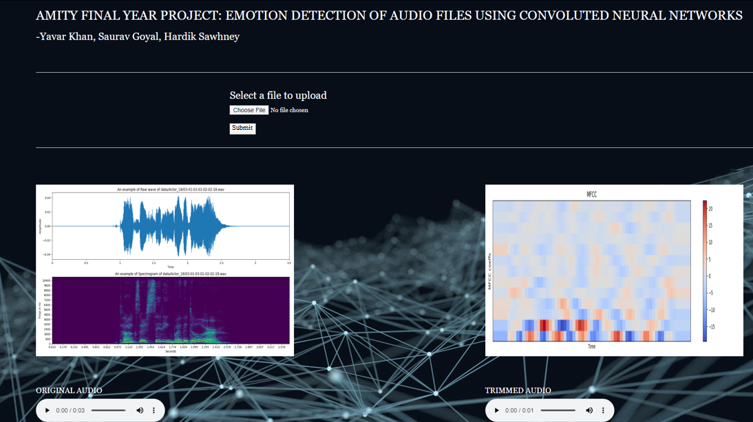

Slide 5
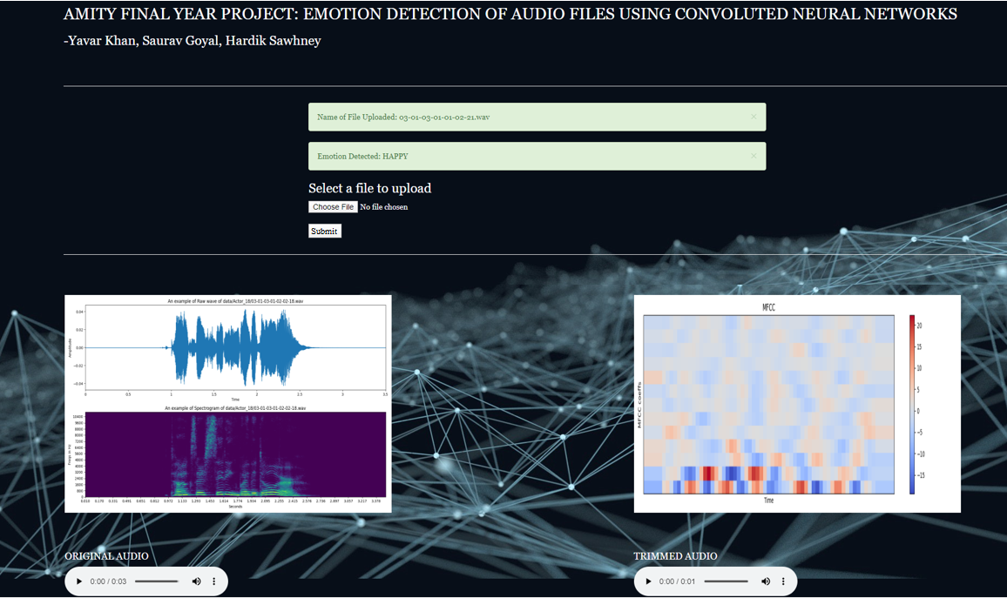

Slide 6

THE RYERSON AUDIO-VISUAL DATABASE OF EMOTIONAL SPEECH AND SONG (RAVDESS)
The Ryerson Audio-Visual Database of Emotional Speech and Song contains twelve male and female actors each vocalizing two lexically matched statements in North American accent. The speech includes different kinds of emotions like happy, calm, sad, angry, fearful etc. Each of the expressions are produced in two different levels of emotional intensity (normal and strong), with an added neutral expression.
Each file was assessed and rated 10 times on emotional validity and genuineness. These ratings were provided by around 250 untrained research participants from North America. Adding to this, a further set of 70-75 participants provided test retest data. High levels of validation were being reported for the database.

Slide 7
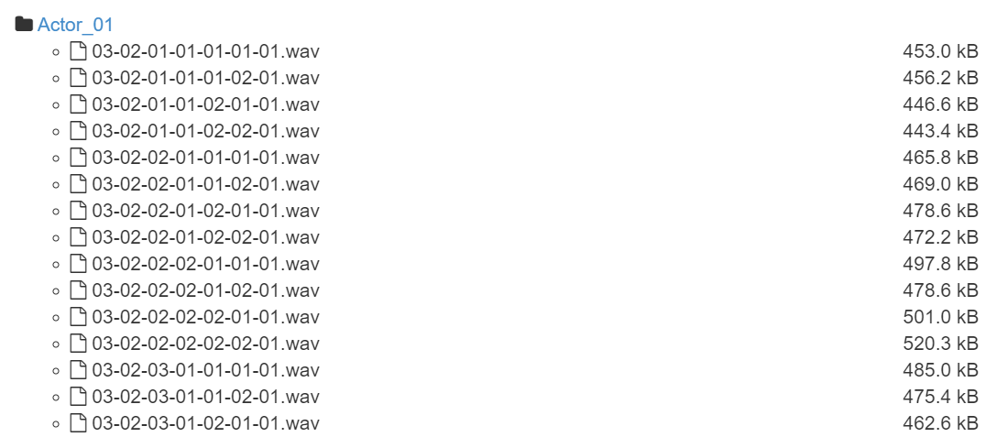
RAVDESS
FILE NAME CONVENTION
Each of the 7356 RAVDESS files has a unique filename. The filename consists of a 7-part numerical identifier (e.g., 02-01-06-01-02-01-12.wav).
Filename identifiers
Modality (01 = full-AV, 02 = video-only, 03 = audio-only).
Vocal channel (01 = speech, 02 = song).
Emotion (01 = neutral, 02 = calm, 03 = happy, 04 = sad, 05 = angry, 06 = fearful, 07 = disgust, 08 = surprised).
Emotional intensity (01 = normal, 02 = strong). NOTE: There is no strong intensity for the 'neutral' emotion.
Statement (01 = "Kids are talking by the door", 02 = "Dogs are sitting by the door").
Actor (01 to 24. Odd numbered actors are male, even numbered actors are female).
Filename example: 02-01-06-01-02-01-12.wav
Video-only (02)
Speech (01)
Fearful (06)
Normal intensity (01)
Statement "dogs" (02)
1st Repetition (01)
12th Actor (12)
Female, as the actor ID number is even.

Slide 8
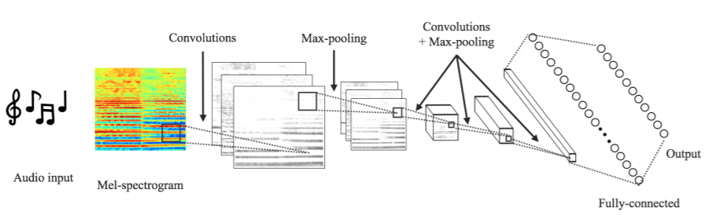
CONVOLUTIONAL NEURAL NETWORK (CNN)
WHY CONVOLUTIONAL NEURAL NETWORK?
CNN has various advantages as compared to other training models such as faster processing, less complexity and less dense network.
CNN has a simple architecture in which the neurons of each layer are not connected to all the other neurons of the intermediate layer thus reducing the complexity and time.
In CNN, each pixels is considered as an input. The input pixels are stored in the form of a matrix. CNN is used for reducing the dimensionality of the input matrix.
There are 3 important steps for doing this in CNN:
Convolutional operation
Pooling
Flattening
A convolutional neural network is a class of neural networks, commonly applied to analyzing visual imagery. The convolutional neural network is a specialized type of neural network model that is designed for working with image data of different dimensions.

Slide 9
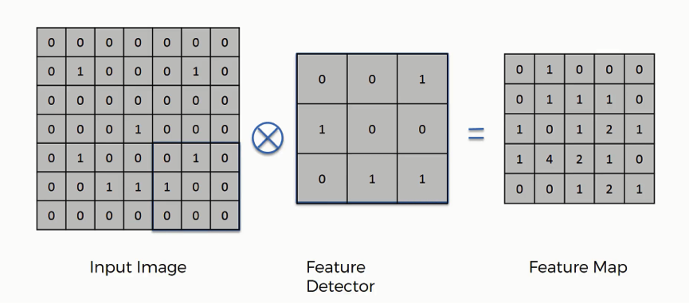
WORKING OF CNN
1. CONVOLUTIONAL OPERATION
In convolutional operation we need 2 matrices, one representing the image and second matrix representing the kernel (feature detector) in order to find the most relevant feature of the given image.
But there are a large numbers of feature detectors that can be used in the algorithm.
Convolutional neural network uses a large number of kernels and during the training period it eventually selects the best possible.
After applying the feature detector on the original image we end up with a feature map.

Slide 10
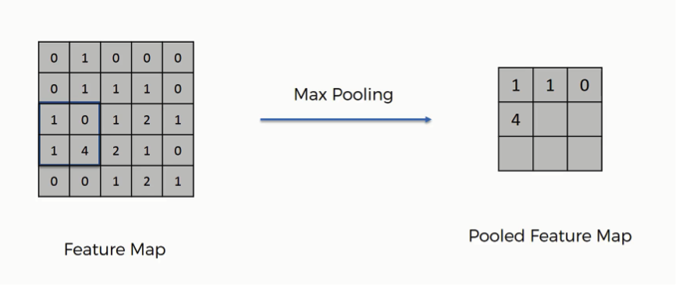
WORKING OF CNN
2. POOLING
Pooling is applied to the feature maps.
With pooling we deal with spatial invariance. We just care about the most relevant features of the input and not the background noise.
The output after pooling would be a feature map with most prominent features of the previous one.
There can be many types of pooling operations like max pooling, average pooling etx. Max pooling is considered to be the best one as it gives the most relevant features

Slide 11
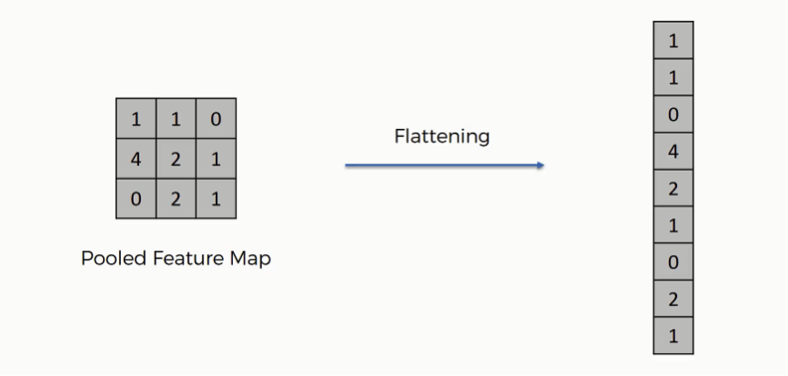
WORKING OF CNN
3. FLATTENING
We transform the matrix that we got after the pooling operation into an one dimensional vector.
These value will act as the input of the standard densely connected neural network.
We can have as any numbers of convolutional layers and pooling layers in our neural network.

Slide 12
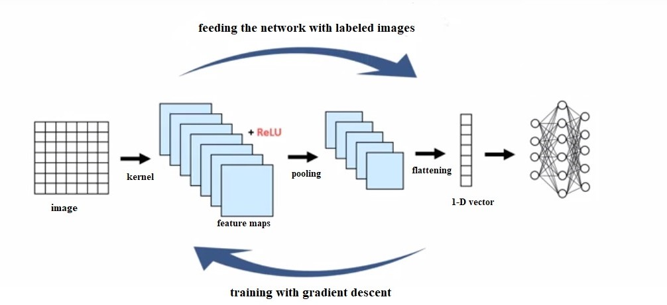
FULL ARCHITECTURE OF CONVOLUTIONAL NEURAL NETWORK

Slide 13
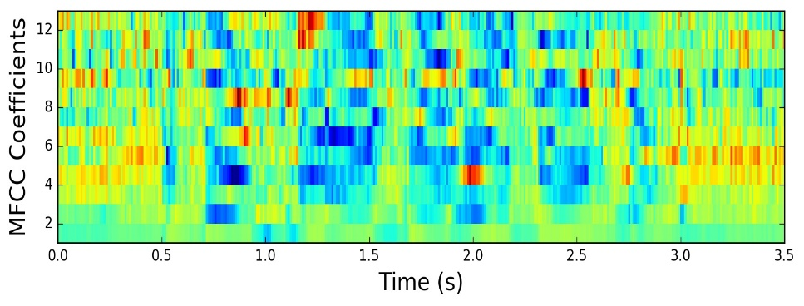
Mel Frequency Cepstral Coefficient (MFCC)
The Mel Frequency Cepstral Coefficients (MFCCs) of a signal are a small set of features which concisely describe the overall shape of a spectral envelope.
MFCCs can easily identify the frequency and amplitude of the sound wave coming from the voice of a person and can plot it in the form of a graph.
MFCC represents audio signals in 3 dimensions.
Each of the audio file is converted to it’s MFCC representation and then passed as an input in the model. MFCC is the most used representation of the spectral property of voice signals.

Slide 14
STEPS FOLLOWED IN THE PROJECT
MAKING ALL THE NECESSARY IMPORTS
DATAFRAME GENERATION
TRIMMING THE SILENCE VOICES
PLOTTING WAVEFORM AND SPECTOGRAM
SELECTING THE TYPE OF LABEL SET
EXTRACTING FEATURES (ASSIGNING LABELS TO THE DATASET)
USING AUGMENTATION METHODS
STRATIFIED SHUFFLE SPLIT (SPLITTING DATASET INTO TESTING AND TRAINING DATA)
MODEL GENERATION AND TRAINING
CALLING THE PREDICTION FUNCTION FROM FLASK WEBPAGE

Slide 15
LIBRARIES AND PACKAGES USED
Pandas: used for data manipulation and analysis (data frame generation).
LibROSA: used for music and audio analysis. We can use it to display audio files in different formats such as waveform, spectrogram, colormap etc.
Matplotlib: used for 2D plots of arrays. All the graphs (MFCC,spectrogram etc) have been plotted using matplotlib.
Sklearn: provides a range of supervised and unsupervised learning algorithm which can be imported in our code and can be used to build models. Also used in Stratified shuffle split.
Keras: used for deep learning models. It provides high level APIs for building and training of deep learning models like neural networks. It is built on TensorFlow. We can use this library to quickly build neural networks without worrying about the internal aspects like algebra, optimization methods etc.
Json: It is mainly used for serialization and deserialization of json files. We have used it to save our trained model for future use.

Slide 16




DEVELOPMENT TOOLS AND TECHNIQUES USED
AMAZON EC2
PYTHON
LINUX
FLASK
PuTTY
PuTTYgen

Slide 17
KEY LEARNINGS
Convolutional neural networks proved to be the best algorithm for our project and got us the best results.
We learnt about a new concept called overfitting and how to deal with it. We have made used of 2 augmentation methods to deal with overfitting and to increase our data.
We tried training our model with 3 labels and then with 5 label data set. We found out that, as the number of labels increases, the accuracy of the model decreases significantly.
Quality of the dataset has a direct impact on the accuracy of the model. So, if we have a good dataset, our model will train better and hence make better predictions.
One of the most important learnings was that it is relatively straight forward to implement various machine learning/deep learning models using Python libraries like TensorFlow and sklearn, once you have a basic understanding of how the models work mathematically. The tricky part that takes up the majority of time and effort is the pre-processing and manipulation of the dataset. Python libraries like pandas effectively simplify and optimize the important first step of bringing the data in the right format.

Slide 18
DRAWBACKS
The model is unable to detect fake emotions of the user and may not provide accurate results.
Only single language (English) data set is used and if data sets of other languages are used then the model might not be able to recognize and interpret the information.
Users from different geographical locations will have different tone, accent and display of emotions will vary from person to person. As we move from one continent to another, the way of communicating and accent changes to a certain extent. For Ex: American English is different from British English.
Both Male and Female both cannot be tested at the same time. Although both the datasets can be used but it was noticed during our project implementation that the accuracy of the model changes significantly when both the datasets are used at the same time. To achieve a decent accuracy we are using only one dataset at a time.

Slide 19
FUTURE WORK
Generalizing our project to languages other than English.
We can further try a combination of multiple algorithms to see how it impacts the accuracy of the overall model.
Working towards real time speech emotion recognition system so that we can take human inputs in real time and then predict their emotions accurately.
As of now, we are restricted only to audio data, we will be working on integration of other modalities like videos and image recognition.
Once we are successful in achieving a good accuracy, we are planning to integrate our project with google home and other smart devices.

